Slide 1
Scientific Foundations of Health
Unit-1

Slide 2
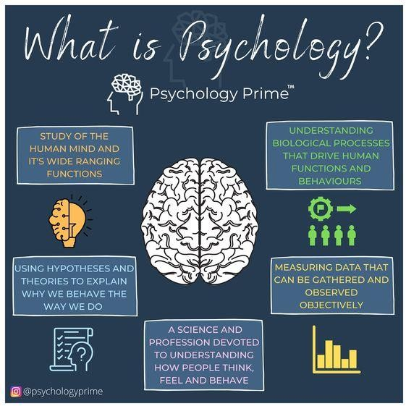
Health and psychology
Psychology is the scientific study of the mind and behavior
Health and Well‒Being describes psychological well-being as “the combination of feeling good and functioning effectively.”

Slide 3
What is Health Psychology
Psychology is the scientific study of the mind and behavior.
Health psychology is the study of psychological and behavioral processes in health, illness, and healthcare.
It is concerned with understanding how psychological, behavioral, and cultural factors contribute to physical health and illness.
Psychological study focuses on:
health promotion and maintenance
the psychological aspects of the prevention and treatment of illness.
The analysis of health psychologists and attempt to improve the health care system and the formulation of health policy.

Slide 4
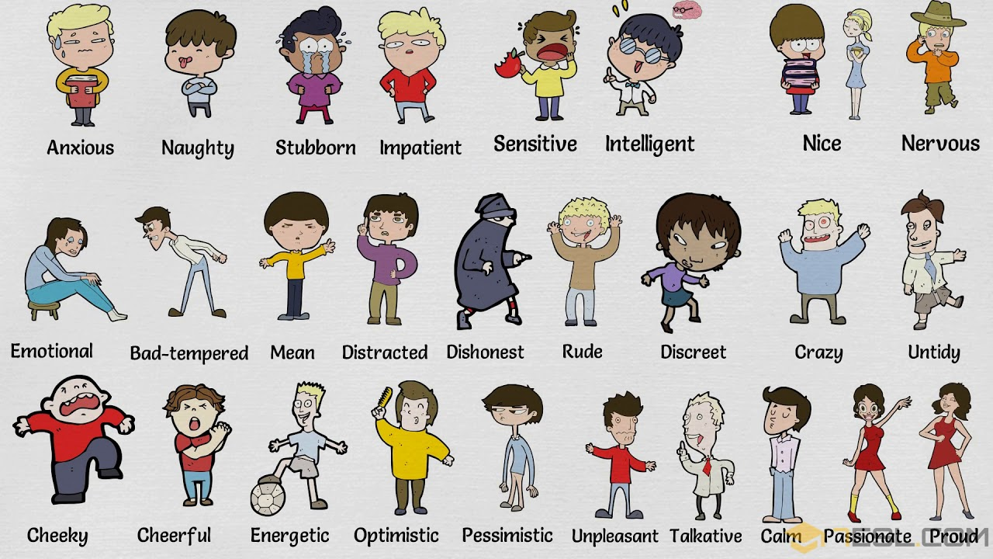

Slide 5
Methods To Improve Good Psychological Health
1. Make social connections: epecially face-to-face a priority
Phone calls and social networks have their place, but few things can beat the stress-busting, mood-boosting power of quality face-to-face time with other people.
2. Stay active
Staying active is as good for the brain as well as for the body. Regular exercise or activity can have a major impact on your mental and emotional health, relieve stress, improve memory, and help you sleep better.

Slide 6
Methods To Improve Good Psychological Health
3. Talk to someone
Talk to a friendly face. In-person social interaction with someone who cares is one of the most effective ways to calm your nervous system and relieve stress.
4. Appeal to your senses
Does listening to an uplifting song make you feel calm? What about taking a walk in nature and enjoying the sights and sounds of the trees? Everyone responds to sensory input a little differently, so experiment to find what works best for you.
5. Take up a relaxation practice
Yoga, mindfulness, meditation and deep breathing can help reduce overall levels of stress.

Slide 7
Methods To Improve Good Psychological Health
6. Make leisure and contemplation a priority
Leisure time is a necessity for emotional and mental health. Take some time to relax, contemplate, and pay attention to the positive things as you go about your day — even the small things. Write them down if you can, because they can be easy to forget. Then you can reflect on them later if your mood is in need of a boost.
7. Eat a brain-healthy diet to support strong mental health
Foods that can support your mood include fatty fish rich in omega-3s, nuts (walnuts, almonds, cashews and peanuts), avocados, beans, leafy greens (spinach, kale and Brussels sprouts), and fresh fruit such as blueberries.

Slide 8
Methods To Improve Good Psychological Health
8. Don’t skimp on sleep
It matters more than you think. One way to get sleep better is to take a break from the stimulation of screens — TV, phones, tablets or computers — in the two hours before bedtime.
9. Find purpose and meaning
This is different for everyone. You might try one of the following: Engage in work that makes you feel useful
Invest in relationships and spend quality time with people who matter to you
Volunteer, which can help enrich your life and make you happier
Care for others, which can be as rewarding and meaningful as it is challenging

Slide 9
Psychological Disorders
Psychological Disorder a “harmful dysfunction” in which behavior is judged to be (text discussion):
Atypical
not enough in itself
Disturbing
varies with time and culture
Maladaptive
harmful
Unjustifiable
By what standard?

Slide 10
Psychological Disorders
Neurodevelopmental Disorders
Intellectual Disability
Global Developmental Delay
Communication Disorders
Autism Spectrum Disorder
Attention-Deficit Hyperactivity Disorder (ADHD)
Bipolar and Related Disorders
Mania
Depressive Episode

Slide 11
Psychological Disorders
Anxiety Disorders
Generalized Anxiety Disorder (GAD)
Agoraphobia
Social Anxiety Disorder
Specific Phobias
Panic Disorder
Separation Anxiety Disorder
Stress-Related Disorders
Acute Stress Disorder
Adjustment Disorders
Dissociative Disorder
Dissociative Amnesia
Dissociative Identity Disorder

Slide 12
Psychological Disorders
Somatic Symptom Disorders
Illness Anxiety Disorder
Conversion Disorder
Eating Disorders
Anorexia Nervosa
Bulimia Nervosa
Rumination Disorder
Pica
Sleep Disorders
Narcolepsy
Insomnia Disorder
Hypersomnolence
Breathing-Related Sleep Disorders
Parasomnias
Restless Legs Syndrome

Slide 13
Psychological Disorders
Disruptive Disorders
Intermittent Explosive Disorder
Oppositional Defiant Disorder
Depressive Disorders
Depressive Disorders
Major depressive disorder:
Dysthymia
Substance/medication-induced depressive disorder

Slide 14
Mind : Defined as Function
Individual is not functioning adequately based on either his/her standards or according to significant others in the person’s life.
Almost all the disorders we discuss have symptoms that everyone experiences. Diagnosis of disorder depends of intensity, length of time and how much it’s impacting on the person.
Depression
Anxiety
Psychosis?

Slide 15
Medical Model
concept that diseases have physical causes
can be diagnosed, treated, and in most cases, cured
assumes that these “mental” illnesses can be diagnosed on the basis of their symptoms and cured through therapy, which may include treatment in a psychiatric hospital

Slide 16
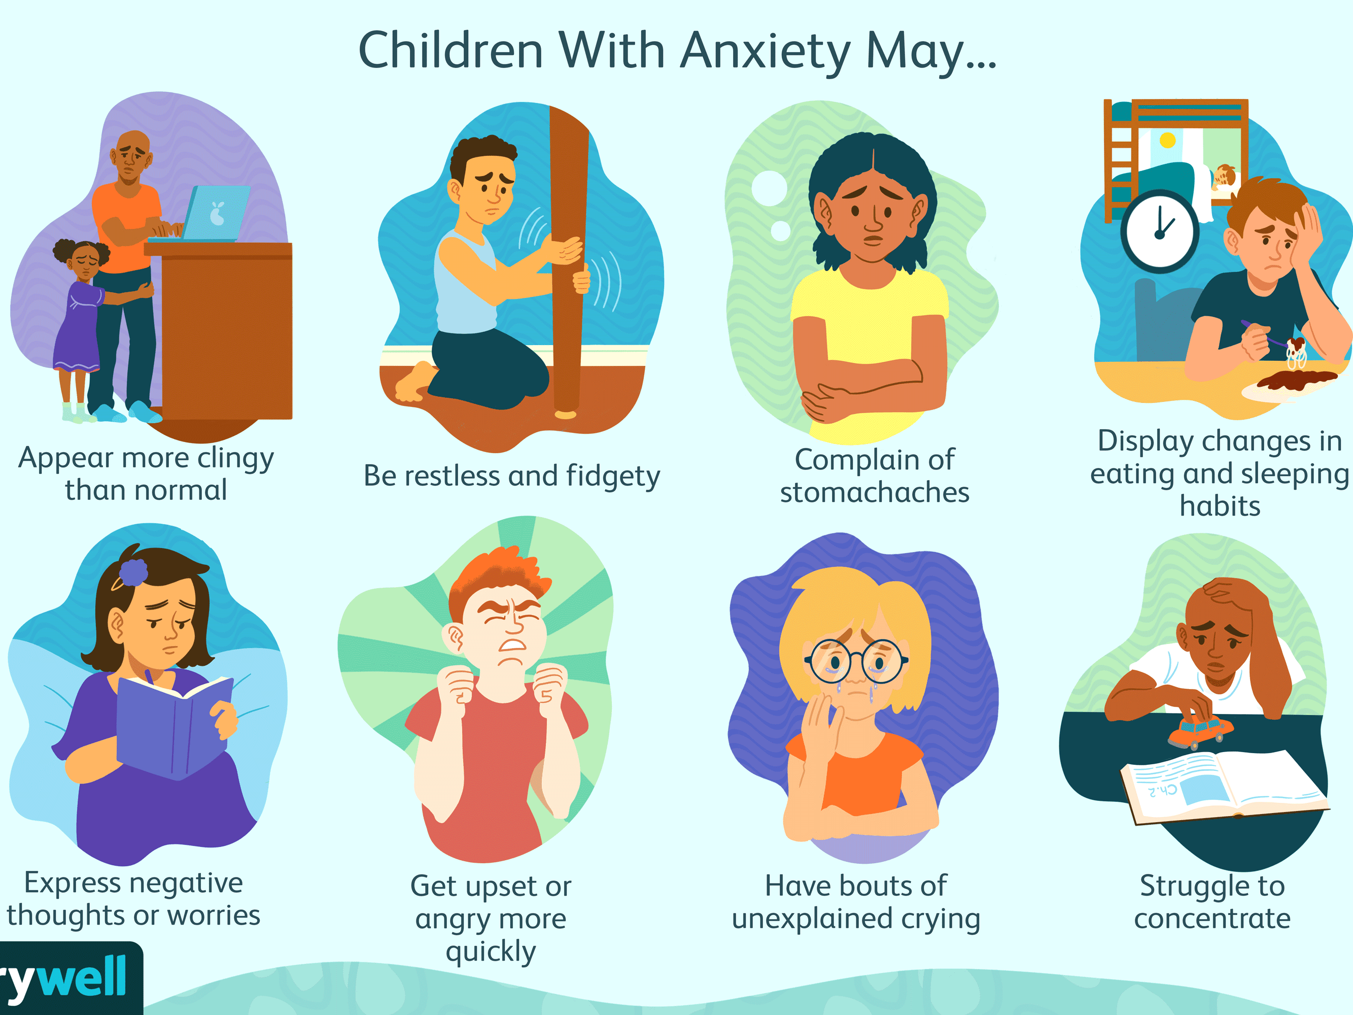
Anxiety Disorders
distressing, persistent anxiety or maladaptive behaviors that reduce anxiety
Generalized Anxiety Disorder
person is tense, apprehensive, and in a state of autonomic nervous system arousal
Persistence (out of control)
Problem in identifying source

Slide 17
Anxiety Disorders / Panic Disorders
marked by a minutes-long episode of intense dread in which a person experiences terror and accompanying chest pain, choking, or other frightening sensation
Person comes to fear the panic attack itself and start to avoid any situations or places that might provoke an attack

Slide 18
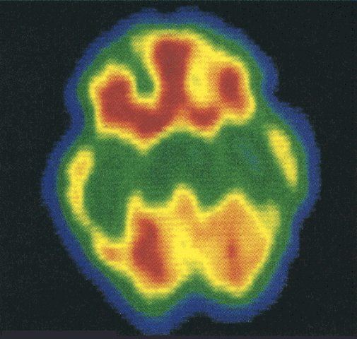
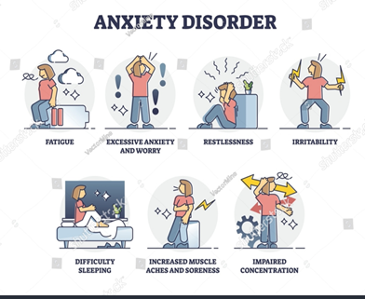
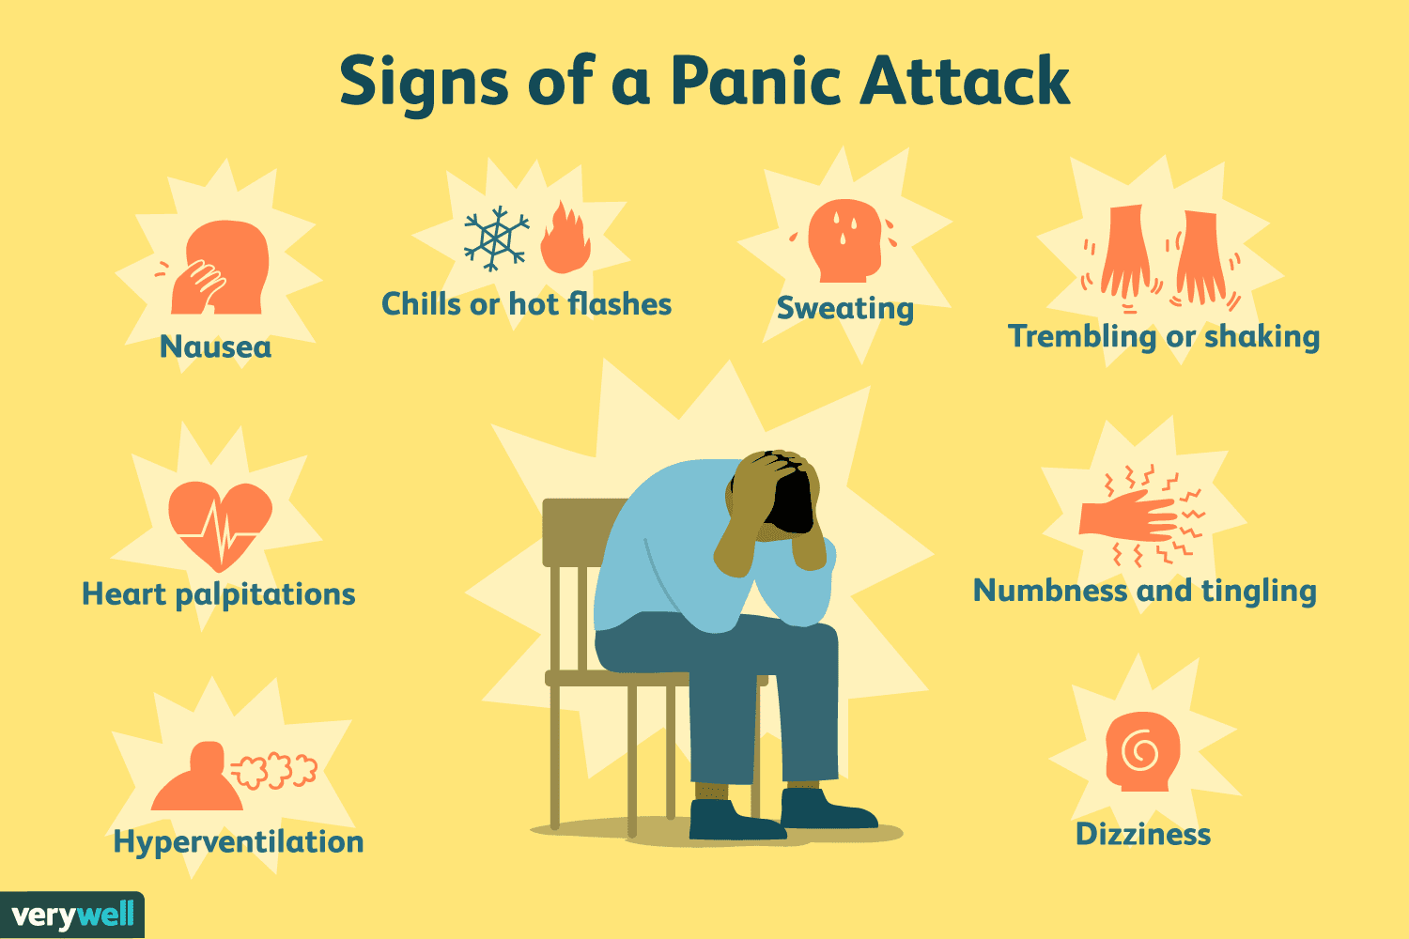
Anxiety Disorders / Panic Disorders
PET Scan of brain of person with Obsessive/ Compulsive disorder
High metabolic activity (red) in frontal lobe areas involved with directing attention (impulse control and executive function)
Effectiveness of drug therapy

Slide 19
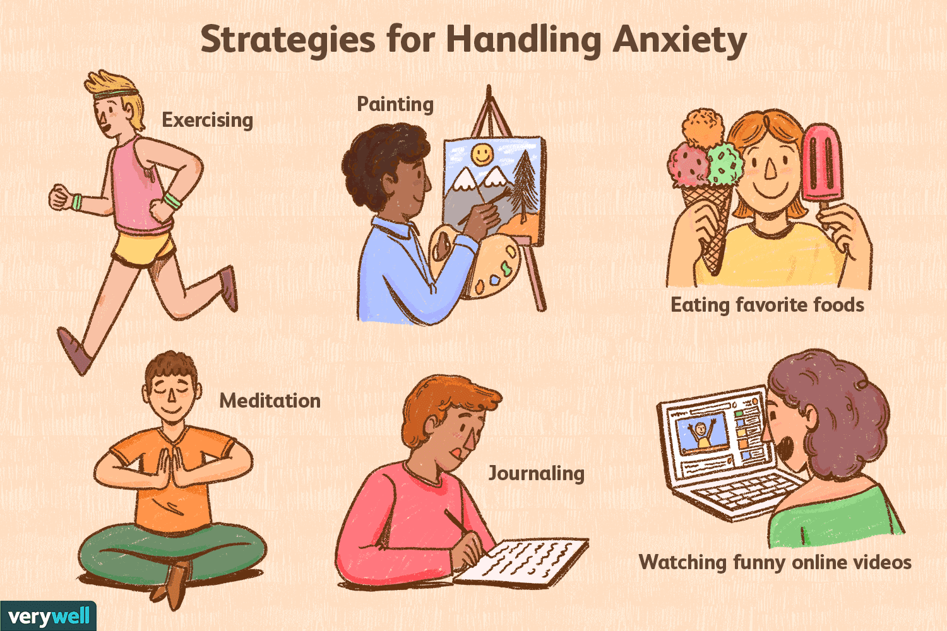
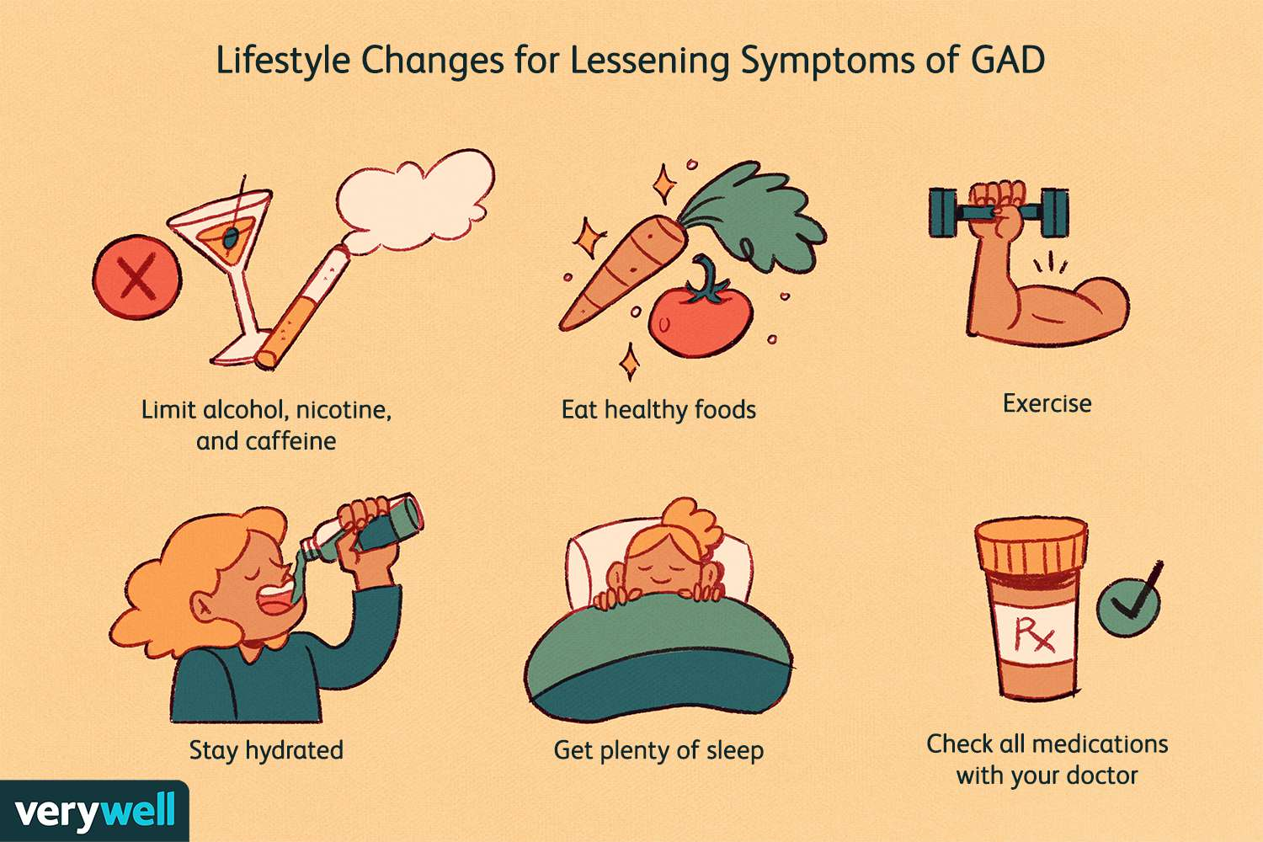
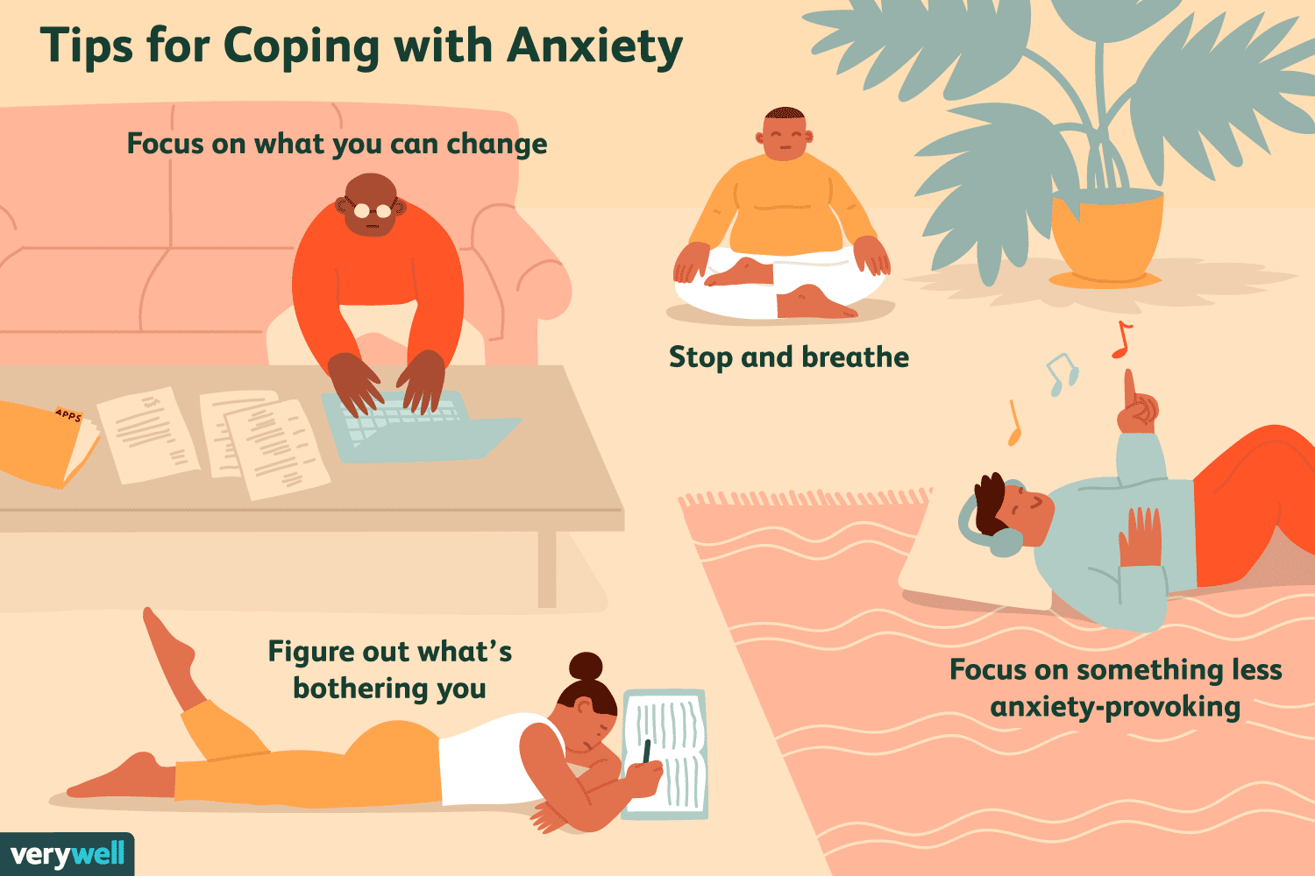

Slide 20
Dissociative Disorders
Dissociative Disorders
conscious awareness becomes separated (dissociated) from previous memories, thoughts, and feelings
Not uncommon when in a highly traumatic situation to feel “removed” from the situation. Problem is when this becomes more then a brief situation

Slide 21
Personality Disorders
Personality Disorders (vs. mood disorder)
disorders characterized by inflexible and enduring behavior patterns that impair social functioning

Slide 22
Types of Personality Disorders
Fearful, afraid of rejection, withdrawn
Extreme eccentrics– “The Character”
Narcissistic– Over exaggerates self importance
Borderline– Unstable identity, emotions, relationships, etc.

Slide 23
Personality Disorders
Antisocial Personality Disorder
disorder in which the person (usually man) exhibits a lack of conscience for wrongdoing, even toward friends and family members
may be aggressive and ruthless or a clever con artist
Most criminals do not have this– they show concern for family and friends

Slide 24
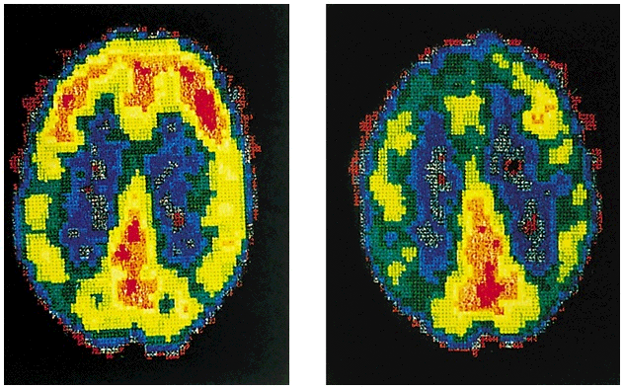
Personality Disorders
PET scans illustrate reduced activation in a murderer’s frontal cortex
Normal
Murderer

Slide 25
Mood Disorders
Mood Disorders
characterized by emotional extremes
Major Depressive Disorder
a mood disorder in which a person, for no apparent reason, experiences two or more weeks of depressed moods, feelings of worthlessness, and diminished interest or pleasure in most activities

Slide 26
Mood Disorders
Manic Episode
a mood disorder marked by a hyperactive, wildly optimistic state
Bipolar Disorder
a mood disorder in which the person alternates between the hopelessness and lethargy of depression and the overexcited state of mania
formerly called manic-depressive disorder

Slide 27
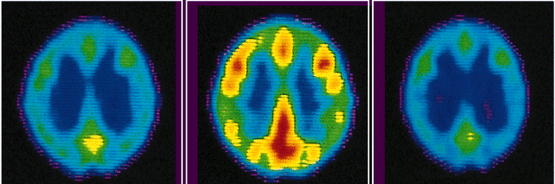
Mood Disorders-Bipolar
PET scans show that brain energy consumption rises and falls with emotional switches
Depressed state
Manic state
Depressed state

Slide 28
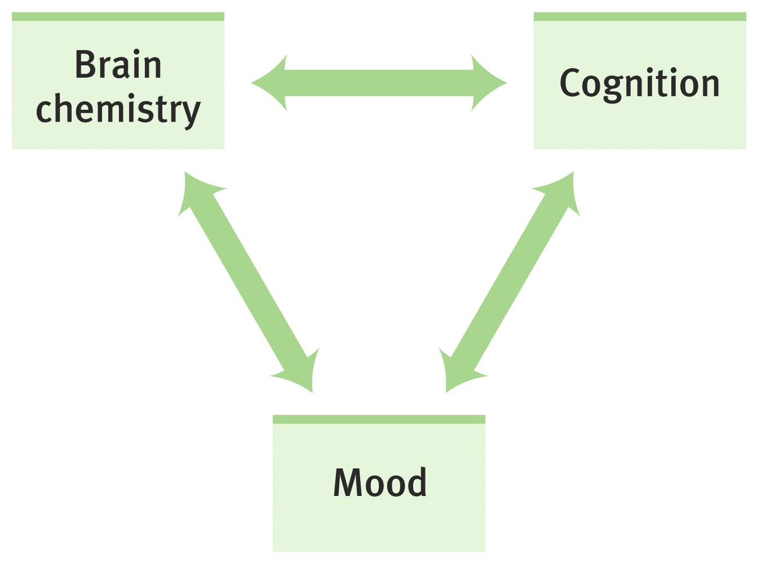
Mood Disorders-Depression
Altering any one component of the chemistry-cognition-mood circuit can alter the others

Slide 29
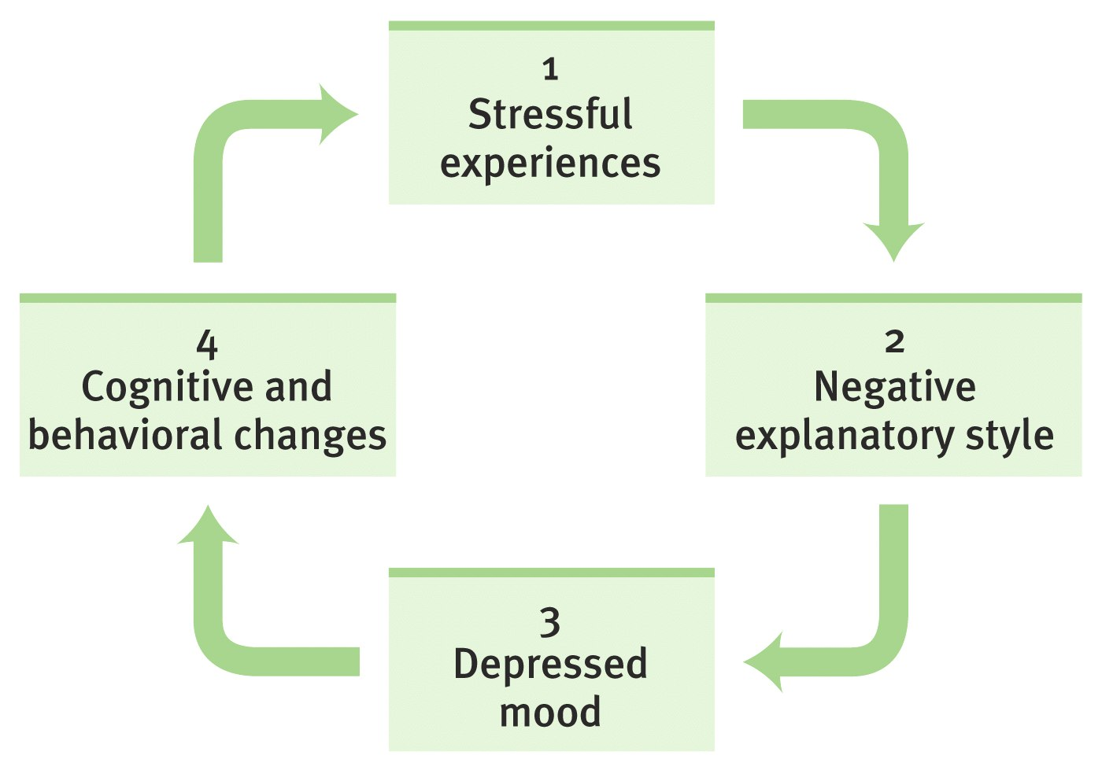
Mood Disorders-Depression
The vicious cycle of depression can be broken at any point

Slide 30
What is Stress?
Stress can be defined as our mental, physical, emotional, and behavioral reactions to any perceived demands or threats.
Notes:
We say we feel "burned out," stressed out, overwhelmed, angry, irritable, depressed, anxious, and on the verge of "losing it."

Slide 31
The “Fight or Flight” Response
When situations seem threatening to us, our bodies react quickly to supply protection by preparing to take action. This physiological reaction is known as the "fight or flight" response.
The physiological response to a stressor is known as reactivity Physiological responses can accumulate and result in long-term wear on the body
Notes:
In the days of the cavemen, the fight or flight response was key to their survival. When faced with a threatening tiger, for instance, a caveman had two main choices. He could fight the tiger or he could run away. Either way, his body had to prepare quickly to respond. The caveman's heart began to race, his breathing rate increased, his pupils dilated, his muscles became tense, and his mind processed information rapidly. This natural response to danger helped the cavemen to protect himself and to survive.

Slide 32

What Makes Something Stressful?
Situations that have strong demands
Situations that are imminent
Life transitions
Timing (e.g., deviation from the “norm”)
Ambiguity
Desirability
Controllability

Slide 33
Not All Stress is Bad…
Distress is a continuous experience of feeling overwhelmed, oppressed, and behind in our responsibilities. It is the all encompassing sense of being imposed upon by difficulties with no light at the end of the tunnel.
Examples of distress include financial difficulties, conflicts in relationships, excessive obligations, managing a chronic illness, or experiencing a trauma.
Eustress is the other form of stress that is positive and beneficial. We may feel challenged, but the sources of the stress are opportunities that are meaningful to us. Eustress helps provide us with energy and motivation to meet our responsibilities and achieve our goals.
Examples of eustress include graduating from college, getting married, receiving a promotion, or changing jobs.

Slide 34
Stress Response: Example
A good example of a stressful situation for many people is taking a test. If you find testing to be stressful, you might notice certain physical, behavioral, mental, and emotional responses.
Physical Response?
Behavioral Response?
Mental Response?
Emotional Response?
Notes:
This may not be a life and death situation, but many of us perceive this situation as somewhat threatening.
Physically, your heart might race, your hands become clammy or sweaty, you shake, your breathing becomes rapid and shallow, your jaw tightens, and you might become light-headed.Behaviorally, you might stutter, look down, or avoid eye contact with the audience.Cognitively or mentally, your mind may go blank, or alternatively your thoughts might race wildly. You might have thoughts about making a mistake or looking ridiculous in front of your peers.Emotionally, you might feel very anxious or fearful.

Slide 35
What is Stressful to You?
Work | Roommate | Legal matters
Classes | Childcare | Mental health
Studying | Finances | Law violation
Relationship with partner | Appearance | Spiritual/Religious issues
Relationship with family | Physical Health | Major/Career decisions
Relationship with friends | Not “fitting in” | Attitudes/thoughts
Trauma | Getting married | Buying a house
Change in residence | Change to a new school | Change in amount of recreation
Change in amount of social activities | Change in eating habits | Death of friend/family member

Slide 36
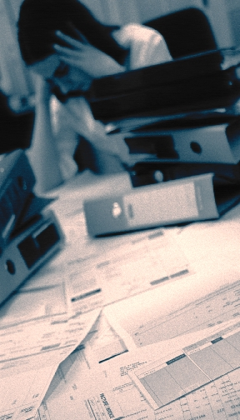
Why Do We "Stress Out"?
For two major reasons:
We perceive a situation as dangerous, difficult, or painful.
We don't believe we have the resources to cope.
Notes:
Our Perceptions = How Stressed We Feel
We often identify specific events, people, or situations that seem to make us feel stressed. It's as if these things automatically cause us feel stressed out. In reality, it's how we perceive an event, the meaning we give to it, that leads us to feel stressed or not stressed about it.
The interesting thing about stress is that it begins with our own perceptions of things!
Have you ever noticed that some people can feel quite stressed out about a particular event while others don't seem to be bothered by it at all? For instance, if three of your friends all get a poor grade on a test, you might notice some different reactions. One friend may seem mildly annoyed for an hour or so. Another friend doesn't seem to be bothered at all. The third friend, however, might become quite alarmed by this poor grade. She can't get it off her mind, she vows to study three times as hard next time, she can't concentrate on her other work, and she might even find it difficult to fall asleep that evening. She might become increasingly concerned about all the grades she'll make this semester, and wonder whether her GPA will suffer.
In a case such as this, a poor grade on a test means something different for each of your friends. The same situation has happened to all three, but each person feels more or less stressed about it because of what it means to him or her.

Slide 37
Stress Warning Signals
What are your "red flags," or warning signs, that stress is creeping into your life? If we keep pushing ourselves, eventually something inside of use will send "red flags," or warning signs that stress is becoming a problem.

Slide 38

Suggestions for Reducing Stress
1. Find a support system. Find someone to talk to about your feelings and experiences.
Notes:
Speak to friends, family, a teacher, a minister, or a counselor. Sometimes we just need to "vent" or get something "off our chest." Expressing our feelings can be relieving, we can feel supported by others, and it can help us work out our problems.

Slide 39
Suggestions for Reducing Stress
2. Change your attitude. Find other ways to think about stressful situations.
"Life is 10% what happens to us, and 90% how we react to it."
Notes:
Talk to yourself positively. Remember, "I can handle it, " "this will be over soon," or "I have handled difficult things before, and I can do it again." Also, practice acceptance. We need to learn to accept things we cannot change without trying to exert more control over them.

Slide 40
Suggestions for Reducing Stress
3. Be realistic. Set practical goals for dealing with situations and solving problems.
Develop realistic expectations of yourself and others.
Notes:
Setting our expectations or goals high may seem like a useful way to push ourselves and get things done, but we may also set ourselves up for disappointment and continued stress. Find the courage to recognize your limits

Slide 41
Suggestions for Reducing Stress
4. Get organized and take charge. Being unorganized or engaging in poor planning often leads to frustration or crisis situations, which most always leads to feeling stressed.
Plan your time, make a schedule, establish your priorities.
Notes:
Do this regularly until it becomes a productive habit. Take responsibility for your life. Be proactive. Problem solve and look for solutions rather than worry.

Slide 42
Suggestions for Reducing Stress
5. Take breaks, give yourself "me time." Learn that taking time to yourself for rejuvenation and relaxation is just as important as giving time to other activities.
At minimum, take short breaks during your busy day.
Notes:
You might purposely schedule time in your day planner just for yourself so that you can recharge for all the other things you need to do. Learn your "red flags" for stress, and be willing to take time to do something about it.

Slide 43
Suggestions for Reducing Stress
6. Take good care of yourself. Eat properly, get regular rest, keep a routine. Allow yourself to do something you enjoy each day.
Paradoxically, the time we need to take care of ourselves the most, when we are stressed, is the time we do it the least.
Notes:
When we feel overwhelmed we tend to eat poorly, sleep less, stop exercising, and generally push ourselves harder. This can tax the immune system and cause us to become ill more easily. If we take good care of ourselves to begin with, we will be better prepared to manage stress and accomplish our tasks in the long run.

Slide 44
Suggestions for Reducing Stress
7. Learn to say "no." Learn to pick and choose which things you will say "yes" to and which things you will not.
Protect yourself by not allowing yourself to take on every request or opportunity that comes your way.
Notes:
It is okay to decline a request for a favor. Saying "no" does not mean you are bad, self-centered, or uncaring. Learn skills of assertiveness so that you can feel more confident and have effective ways of saying "no."

Slide 45
Suggestions for Reducing Stress
8. Get regular exercise. Exercising regularly can help relieve some symptoms of depression and stress, and help us to maintain our health.
Notes:
Exercise can build confidence, self-esteem, and self-image.
It is also a great way to take time for yourself, blow off steam, and release physical tension.

Slide 46
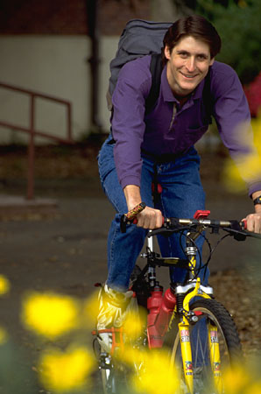
Suggestions for Reducing Stress
9. Get a hobby, do something different. For a balanced lifestyle, play is as important as work.
Notes:
Leisure activities and hobbies can be very enjoyable and inspiring, and they can offer an added sense of accomplishment to our lives. For ideas on new hobbies, browse through a bookstore or a crafts store, surf the internet, look up local organizations, see what classes or courses are available in your community or from a nearby college or university. Don't quickly dismiss new opportunities.

Slide 47
Suggestions for Reducing Stress
10. Slow down. Know your limits and cut down on the number of things you try to do each day, particularly if you do not have enough time for them or for yourself.
Be realistic about what you can accomplish effectively each day.
Monitor your pace. Rushing through things can lead to mistakes or poor performance. Take the time you need to do a good job.
Poorly done tasks can lead to added stress.

Slide 48
Suggestions for Reducing Stress
11. Laugh, use humor. Do something fun and enjoyable such as seeing a funny movie, laughing with friends, reading a humorous book, or going to a comedy show.

Slide 49

Suggestions for Reducing Stress
12. Learn to relax. Develop a regular relaxation routine.
Try yoga, meditation, or some simple quiet time.
Notes:
Relaxation techniques are skills that need to be developed with patience and practice so that we can use them effectively during difficult times of stress later on.

Slide 50

Relaxation Exercises
Many different kinds, but 2 are:
Deep Breathing
Visualization: Visualization is a nice way of giving our minds and bodies a "mini vacation."
Notes:
When we feel stressed, it is common for our rate of breathing to increase. We also tend to breath in a shallow manner, more highly in our chest. A deep breathing exercise allows us to take fuller, slower breaths that reflect a true relaxed state
It involves using imagery to fully immerse ourselves in a pleasant scene, noticing the sights, sounds, smells, and tactile sensations.

Slide 51
Stress Management: Next Steps
Try to change the way you appraise a situation to make it less stressful
Remember stress is normal but watch out for symptoms of stress
Use coping skills/ways to reduce stress
Practice relaxation techniques
Contact TRiO advisor for counseling at 662-4365

Slide 52
Mindfulness for spiritual and Intellectual Health
Mindfulness exercises are ways of paying attention to the present moment using techniques like meditation, breathing, and yoga. Training helps people to become more aware of their thoughts, feelings, and body sensations so that instead of being overwhelmed by them, they're better able to manage them.

Slide 53
Why and how to change the brain
• Making life changes for health starts in the mind- getting out of auto pilot
• Neuroplasticity- using your mind to change your brain to change your mind for the better!
• Work on the mind will change your health Stress, pain, depression and anxiety

Slide 54
Mind Changes Brain
• What flows through the mind changes the brain physiologically
• Increased blood flow to active areas of brain
• Neurons that “Fire together wire together”
• Increasing excitability of active neurons
• Building new synapses, thickening cortex
• Use it or lose it philosophy

Slide 55
Mindfulness
• Attention is like a spotlight, illuminating what it rests upon
• Directing attention skillfully is a fundamental way to shape the brain- over a lifetime
• The brain shapes in increments, not dramatically, over time and practice

Slide 56
Changing health habits for good health
Nutrition: Eat right
Rest : Get optimum sleep
Fitness: exercise regularly
Manage social media time
Medical check-ups
Timely vaccination
Control of substance abuse
Stress Management
Positive self talk
Practicing gratitude
Journaling
Meaningful relationship with family and friends

